Slide 1
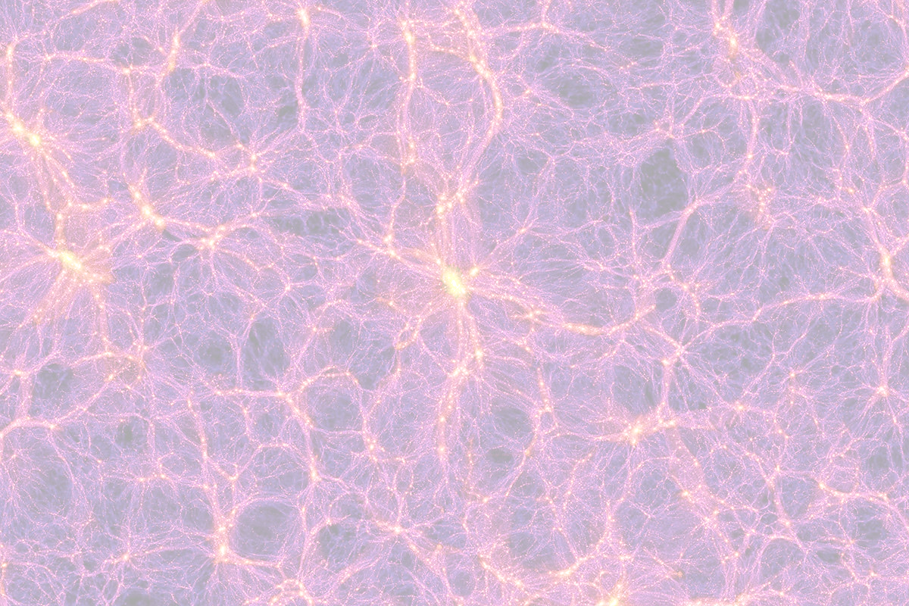
Physics 141 Introduction
Jan 8 2018 / David Moore

Slide 2
Outline of the course
We use astrophysics as a playground for exploring various scientific and numerical principles.
The methods we use are generic to any particle-particle simulation
Homework assignments involve the motion of planets, the rings of Saturn, and what happens in a galaxy-galaxy collision.

Slide 3
A few things we'll work on
Some theory of numerical ordinary differential equations (ODEs): mostly leapfrog, Euler, and Runge-Kutta.
Thermodynamics and statistical distributions (good models of the distribution of stars in a globular cluster or disk galaxy, and how to sample these distributions).
Modeling particle-particle interactions for long range forces (e.g. 1/r^2 laws).

Slide 4
A few things you'll learn in the homework
Practical programming skills.
Data visualization skills (you have to make videos of your simulations)
Basic scientific skills: Making sure your simulations correspond to physical length- and time- scales, and creating clear writeups of your work.

Slide 5
Access to an 80 GPU cluster!!!
More information TBA.
I am told this is based off of Docker and Kubernetes, and allows up to 8 GPUs per container. CUDA is also already installed on the iMacs in this lab. I highly recommend learning CUDA if you have any experience in C/C++, and we can talk more in lab hours.

Slide 6
Some programming logistics
For visualizing the results, creating graphics, or doing small sections of the assignment, we allow any technology.
I love portable C/C++ and LaTeX projects, but that is just preference.
Jupyter python notebooks (.ipynb) are also very convenient for me!
In more detail...

Slide 7
Allowed programming languages
To do the heavy numerical work (numerical integration, solving for the motion of tens of thousands of particles), you must use one of:
Fortran, or C/C++, or CUDA
For numerical work, I have to be able to compile your code. That means you can't rely heavily on large external libraries!
That said, I'm very open to allowing Python and Matlab this year if it helps you parallelize your work on the GPU cluster.

Slide 8
Videos!

Slide 9
1- Body Problem

Slide 10
Fun n-body videos
https://www.youtube.com/watch?v=yk3VymoLl2o (16 billion particle dark matter simulation)
https://www.youtube.com/user/Nbodyshop/videos

